Slide 1

Mike She
-
Getting started with the interface

Slide 2
The various data types used by Mike She
P
Time series
t
1D river networks
2-D maps

Slide 3
The Mike She calculation sequence
Flow Setup File (.SHE)
Maps
(.dfs2)
Maps
(.dfs2)
Flow Input File (.fif)
BINARY
Maps
(.dfs2)
Time
series (.dfs0)
Time
series (.dfs0)
Time
series (.dfs0)
Time
series (.dfs0)
Time
series (.dfs0)
Maps
(.dfs2)
Time
series (.dfs0)
Maps
(.dfs2)
Time
series (.dfs0)
Maps
(.dfs2)
Time
series (.dfs0)
Result files (DHI internal format)
Data files (DHI internal format)

Slide 4
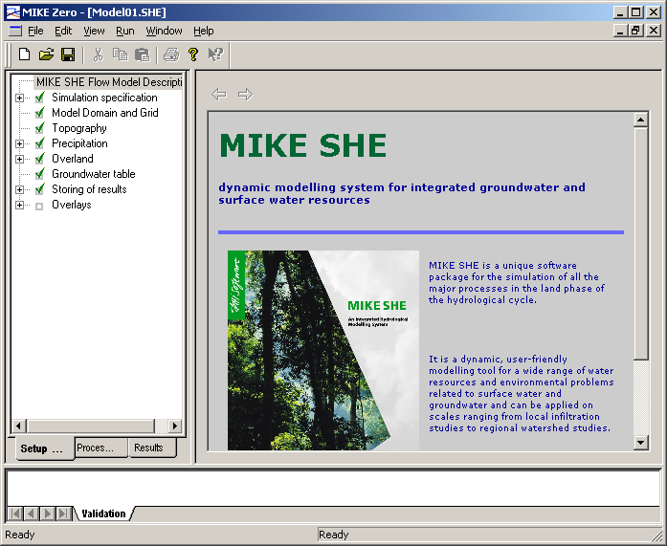
The Main interface
The items to which you are given access (depending on the modelling stage)
Item visualisation and editing
window
The various stages of the modelling process

Slide 5
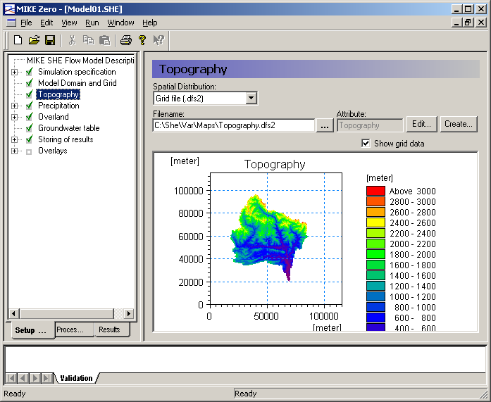
Main interface – Setup mode
Item visualisation and editing
window
The items that you may access (depending on setup progress)
The various stages of the modelling process

Slide 6
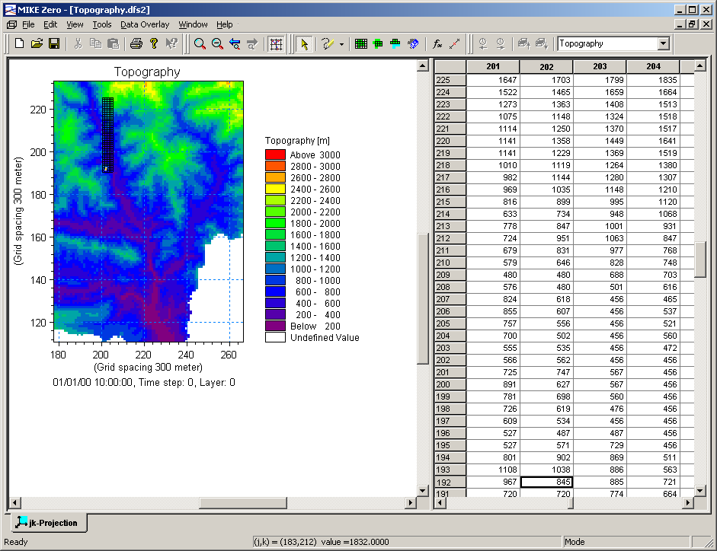
Setup mode – data editing

Slide 7
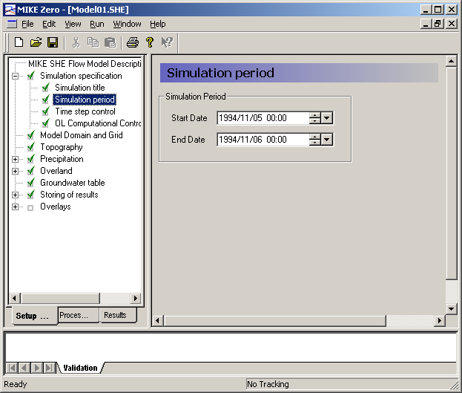
Setup mode – simulation parameters (1)

Slide 8
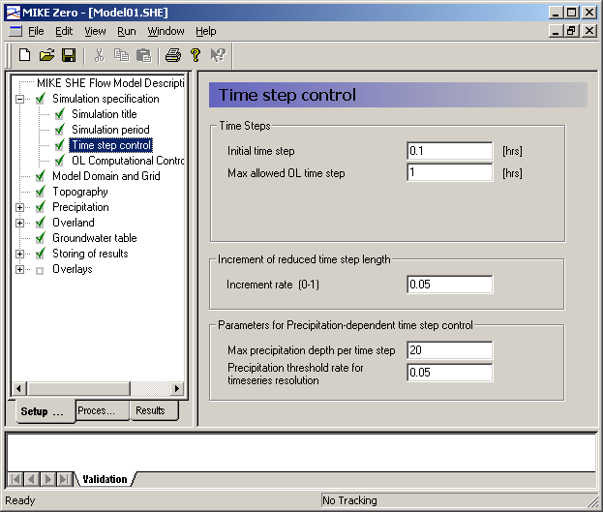
Setup mode – simulation parameters (2)

Slide 9
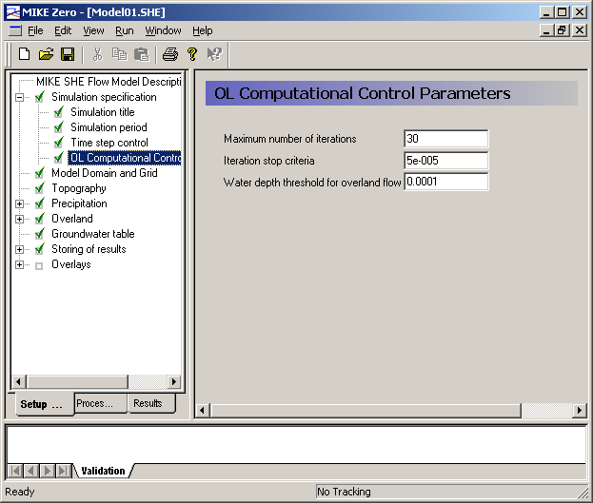
Setup mode – simulation parameters (3)

Slide 10
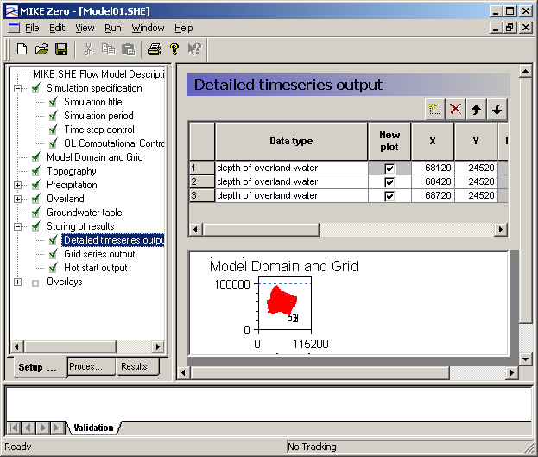
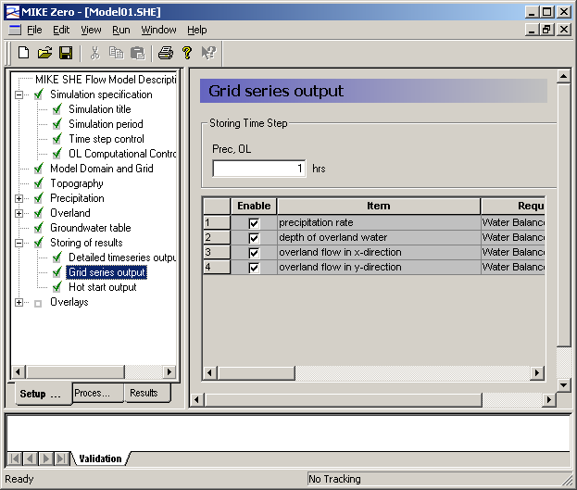
Setup mode – simulation parameters (4)

